Slide 1

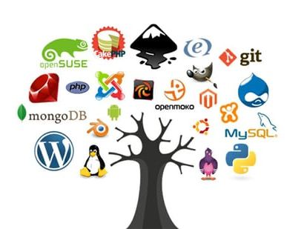
Open Source Software (OSS)
Lecture 07
Git- Remote
Ikram Syed, Ph.D.
Associate Professor
Department of Information and Communication Engineering
Hankuk University of Foreign Studies (HUFS)
Spring − 2025
Notes:
Course overview and Introduction to Algorithms

Slide 2
Announcement
Midterm Exam:
When: Friday, April 25, 2025 Location: Same Classroom
Duration: 09:05 am- 11: 45 am
Total Points= 25
Exam Style:
During the exam, you will be assigned a task to complete. The tasks will involve working on Git and remote Git ( if we covered the contents this week). 2 hours (15 points)
There will be a few theoretical questions, which consists simple why, what and how? You can answer in Just one line. 30 minutes (10 points)

Slide 3
Recap: basics
Git initialization
Tracking a new file
Staging changes in a file
Committing staged changes
Undoing/overwriting a commit
Going back to a commit

Slide 4
Recap: branching
Usual branch-workflow
Creating a branch
Switching to a branch
Merging a branch into current/HEAD branch
Merge conflicts
Command | Task
$ git branch <branch_name> | Create a branch at the HEAD commit
$ git checkout <branch_name> | Change/switch active/HEAD branch
$ git branch | List of local branches
$ git merge <branch_name> | Merge a branch to current HEAD branch
$ git commit –am “merge conflicts resolved” | If auto-merging fails: (1) resolve conflicts in the corresponding file (2) stage and commit the file
$ git log --graph --oneline --all | Check graphical log

Slide 5
Let’s Assess Your Current Progress
Which VCS have you learnt so far?
How could this help you in your project?
Would this be useful for collaborating online?
Would this be useful for OSS contribution and maintenance?
What’s next?
Working on a remote repository (RR)
Today: we will only learn how to contribute to a RR

Slide 6
Remote repositories (RR)
: Versions of your project that are hosted on the Internet
Collaboration involves
Manage remote repositories
Pushing and pulling data to and from them
Remote management
Adding RR
Removing RR
Managing RR branches
Set them as tracked or non-tracked

Slide 7
Sudo adduser “gitusername”
su –gitusername
Ifconfig // sudo apt install net-tools
pwd
Ssh enable ? // sudo systemctl status ssh
sudo apt update
sudo apt install openssh-server
sudo systemctl enable ssh
sudo systemctl start ssh
git clone gitikram@172.20.31.80:/home/gitikram/myproject_1.git

Slide 8
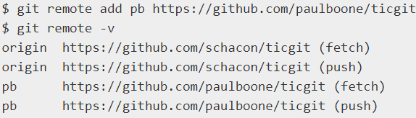
Adding RR
Run git remote add <shortname> <url>
Or, git clone (which implicitly adds the origin remote)
Show remote list using remote or remote –v
Git remote show origin

Slide 9
Fetching / pulling
Fetch
Pulls data from remote that you don’t have yet
Requires explicit merging
Pull
Automatically fetch and merge into your current branch
Use git pull
$ git fetch <remote>

Slide 10
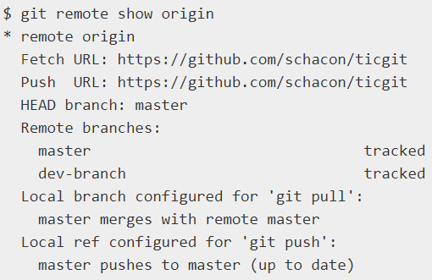
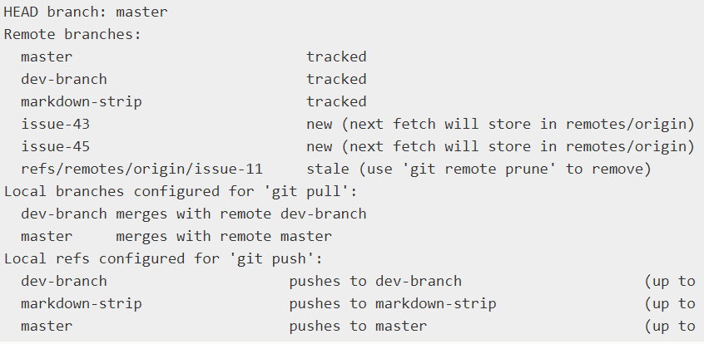
Inspecting a Remote

Slide 11
Remote branches
<remote>/<branch>
e.g.,
origin/master (remote) vs master (local)
origin/iss53 (remote) vs iss53 (local)

Slide 12
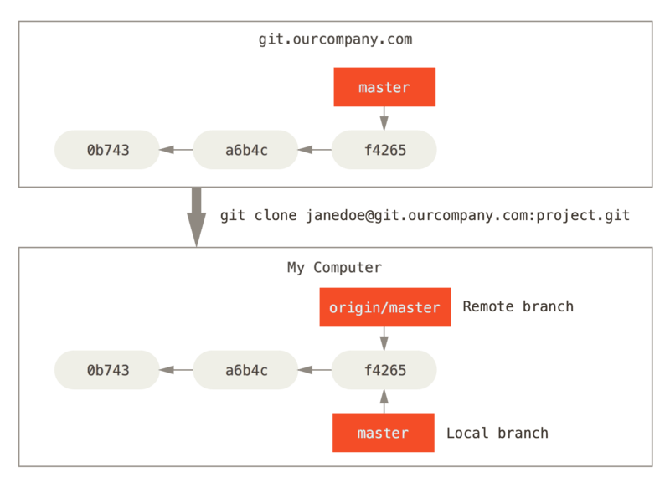
Remote branches (2)
Let’s say:
git server at git.ourcompany.com
After cloning, points to remote master
Names it origin/master
Locally
master branch pointer
Starting at the same place as origin/master

Slide 13
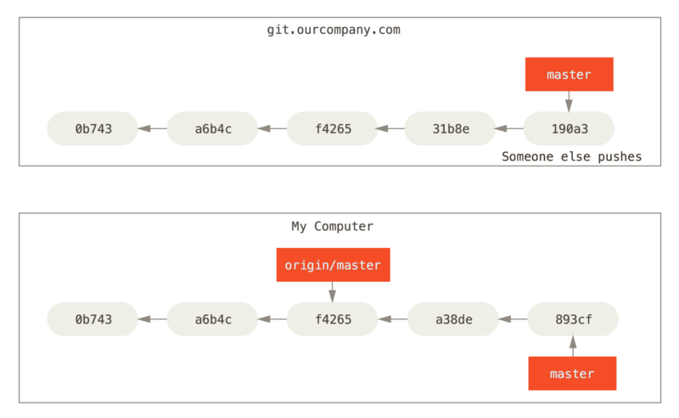
Remote branches (3)
You do some work locally
Which branch is affected?
Someone else also pushes to the server

Slide 14
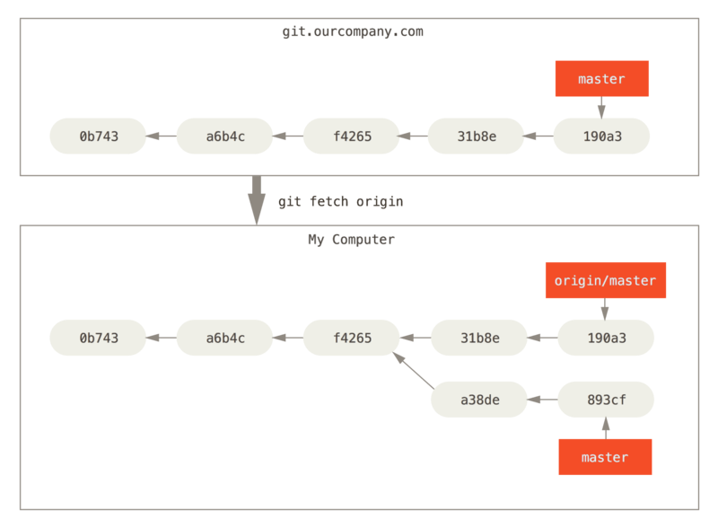
Remote branches: sync
What is the local situation called?

Slide 15
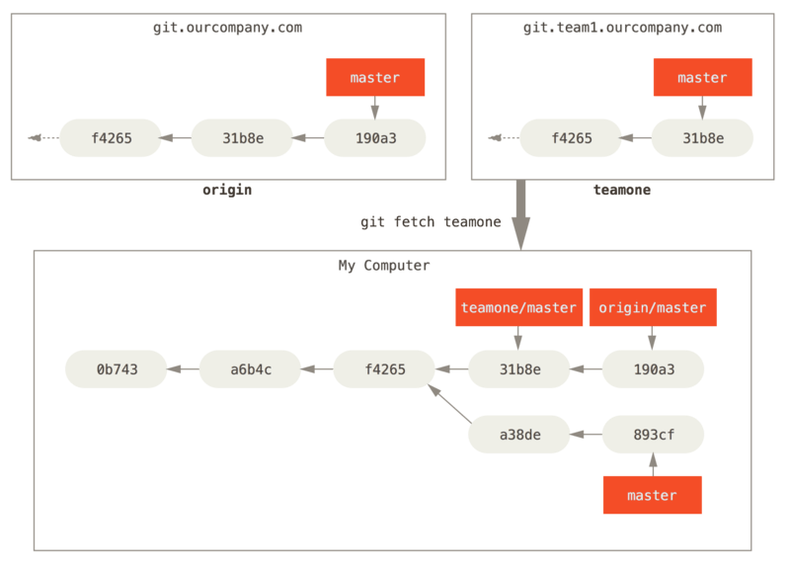
Multiple remotes

Slide 16
Working on a new remote branch
You can’t work on a newly fetched branch
You only have a pointer (origin/serverfix)
You should merge it to a local branch before you start working or, create a local branch at the same commit
git merge origin/serverfix
or
$ git checkout -b serverfix origin/serverfix
Branch serverfix set up to track remote branch serverfix from origin.
Switched to a new branch 'serverfix'

Slide 17
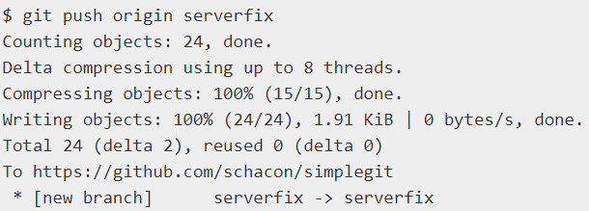
Pushing
You want to share your serverfix branch
Push to existing branch
Note that just “git push” or “git push origin” is also possible
git push origin serverfix:awesomebranch

Slide 18
Successful vs. Unsuccessful Push
Successful Push
When fetched origin/branch is same as the remote branch in the server
i.e., remote branch is a history of the local branch
Unsuccessful Push
When remote branch in the server is updated w.r.t fetched origin/branch
i.e., remote and local branches are divergent
Why so?

Slide 19
Solve unsuccessful push
Fetch-Merge-Push
Fetch to sync, merge to make it non-divergent, now push successfully
git fetch origin, git merge origin/master, git push
Figure out why push will be successful after merging.

Slide 20
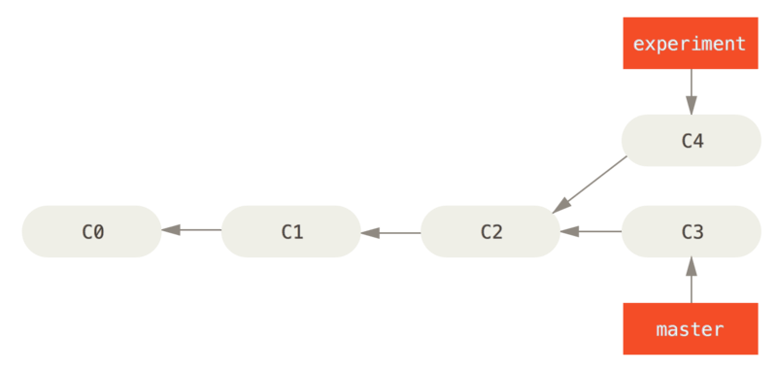
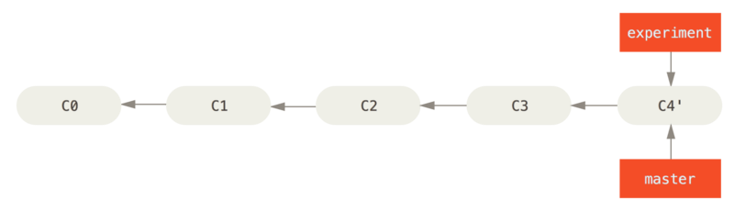

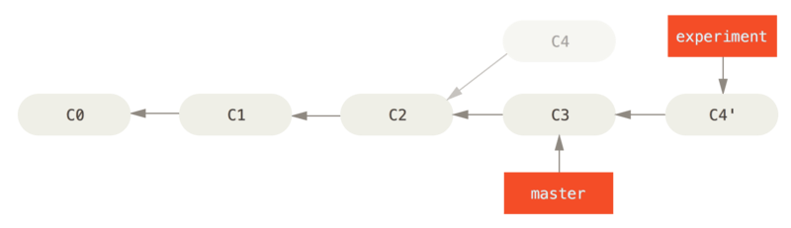

Rebasing
Alternative to merging
Replay changes that were committed on a different branch
E.g., checkout <experiment> and rebase it onto <master>

Slide 21
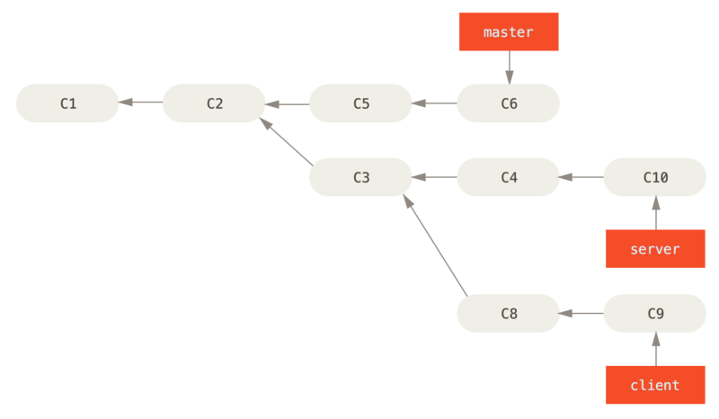
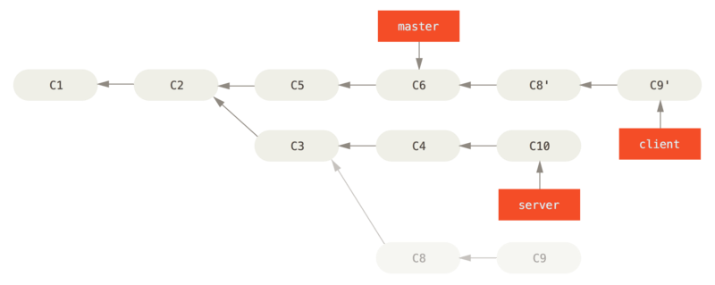
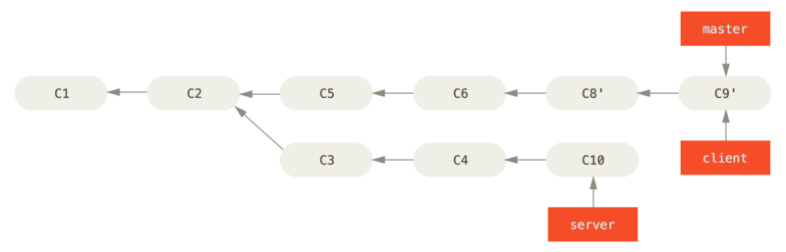
Rebasing (2)
We want to merge the client to the master first
$ git rebase --onto master server client

Slide 22
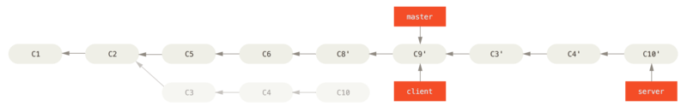
Rebasing (3)
git rebase master server
Note:
Do not rebase commits that exist outside your repository and that people may have based work on.

Slide 23
Labwork on remote
Preparation:
Open a Github account at github.com
Create a folder/directory in your computer
Open a terminal from that directory
Get the remote repository for today’s lab
Comment your github ID under the Eclass assignment so that I can give you access to the following repo.
git clone https://github.com/awjibon/oss2024_intro.git
Go to the oss2024_intro folder (cd oss2024_intro)
(And now you are in the git repository)
Task-1: Checkout to your branch
Check the readme.txt file to find your branch no (e.g., introN).
git checkout introN

Slide 24
Labwork on remote (contd.)
Task-2: Open the intro.txt file, and write your name and department in it.
(format: 이름, 학과)\
Commit the changes as “git commit –am YOUR NAME”
[Therefore, intro<N> branch is updated while origin/intro<N> is still in the previous commit]
Task-3: Now push your branch to origin.
command: `git push origin introN`
[With a successful push, We expect that origin/introN would be updated,
However, the push will be unsuccessful if your friend has pushed to the same branch first. If so, do the following]

Slide 25
Labwork on remote (contd.)
Task-3.1: Do the following only if the push was unsuccessful.
Do Fetch-Merge-Push repeatedly until push is successful
Fetch the updated origin
`git fetch origin`
Merge the remote branch into your branch
`git merge origin/introN`
Push again.
`git push origin introN`

Slide 26
Done for today!
I will check your attendance based on your push to the remote

